Slide 1
Optimization of a Neural Network
Tutorials of Optimization, Lab 1-1
DMKM courses
Tutor: Xinyu WANG
Contact: wangxinyu.xenia@gmail.com

Slide 2
Tutorials Schedule
3 lab sessions
Optimization of a neural network
Classification by support vector machines
The cluster-median problem
2 tutorials for each, 2 hours each tutorial
1 Oct (Today) and 15 Oct (Tue), 2pm-4pm
24 Oct (Thu) 4pm-6pm, and 14 Nov (Thu) 2pm-4pm
21 Nov (Thu) 4pm-6pm, and 3 Dec (Mon) 10am-12am
Homework
Submission within 2 weeks after the 2nd tutorial

Slide 3
A brief overview of Optimization
Unconstrained nonlinear optimization, 3 lec
Fundamentals
Methods that use 1st derivatives
Methods that use 2nd derivatives
Constrained nonlinear optimization, 4 lec
Constrained optimality conditions
Linear equality constrained and linear inequality constrained optimization
Optimization subject to linear equalities and simplex bounds, and the simplex method for linear programming from a basic feasible point
The simplex algorithm with phase 1 and phase 2, and nonlinearly constrained optimization
Integer programming, 2 lec
Modeling and solving integer optimization problems I
Modeling and solving integer optimization problems II, minimum spanning trees

Slide 4
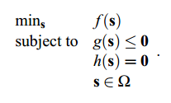
Optimization vs Machine Learning
Machine learning: “learning” from data and generalize a good model for a specific problem, such as classification, prediction …
A model is expressed: y = f_{θ}(x) with θ a set of parameters
Optimization:
Optimization and ML: to get a set of good parameters θ for a ML model y = f_{θ}(x), by optimizing its loss function/cost function

Slide 5
Example with Neural Network
Neural network is a type of algorithms that are used to “learn”. It is widely used in classification problems, for example, application of hand writing recognition.
It learns from existing data, extract a general model for this dataset.

Slide 6
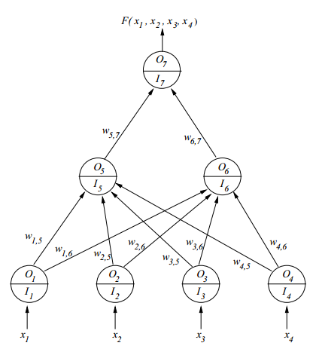
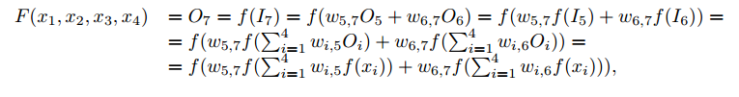

Neural Network
The learning model is:
ωj,i
The parameters are:
The model is actually determined by its parameters. But how to compute a set of “good” parameters that guarantee the precision of this model?
Answer: by loss function
It measures the overall distance between predicted values and real outputs.

Slide 7

The case study
Generate learning data by “genxndat”.
By genxndata, your dataset would follow pattern
To do so is to check the precision of the model.
The larger your dataset is, more precise your model would be, but considering computation efficiency, p=50 is the minimum volume of your dataset.
Initialize weights wj,i
This optimization problem is highly non-linear, it has many local minima. You pick up an initial point w0, and the solver would compute out a local minima.
Attention that it is better to initialize them randomly. Setting them with all 0, all 1 or -1 would lead to a fake minima.
Select a solver for AMPL
There are many available solvers at NEOS server: www-neos.mcs.anl.gov/
Generally, MINOS or MINOSAMP are enough for this problem.
Evaluation of your model
How well does your model classify? Measure: confusion matrix
Observe its classification behavior and write your own learning from this case study.

Slide 8
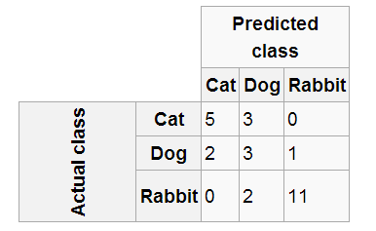
Confusion Matrix
Confusion matrix: is a specific table layout that allows visualization of the performance of an supervised machine learning algorithm, such as Neural Network.
Each column of the matrix represents the instances in a predicted class, while each row represents the instances in an actual class.
It is easy to see if the system is confusing the classes.
In this confusion matrix, of the 8 actual cats, the system predicted that three were dogs, and of the six dogs, it predicted that one was a rabbit and two were cats. We can see from the matrix that the system in question has trouble distinguishing between cats and dogs, but can make the distinction between rabbits and other types of animals pretty well. All correct guesses are located in the diagonal of the table, so it's easy to visually inspect the table for errors, as they will be represented by any non-zero values outside the diagonal. In this confusion matrix, of the 8 actual cats, the system predicted that three were dogs, and of the six dogs, it predicted that one was a rabbit and two were cats. We can see from the matrix that the system in question has trouble distinguishing between cats and dogs, but can make the distinction between rabbits and other types of animals pretty well. All correct guesses are located in the diagonal of the table, so it's easy to visually inspect the table for errors, as they will be represented by any non-zero values outside the diagonal.

Slide 9
About AMPL
A model file and a data file
Model file: declaration of parameters, of variables, and definition of objective function and constraints.
Data file: contains numerical values of the parameters of the model
Solve problem with AMPL solver: MINOS, CPLEX …

Slide 10
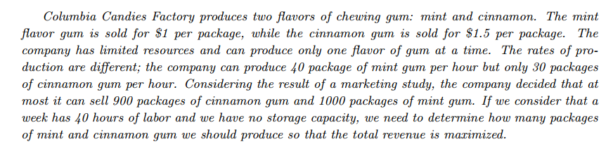
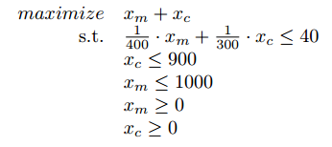
Solving problems in AMPL
xm+1.5xc
Approach 1: Without scripts
Example1.mod
Approach 2: Using Scripts (.run file)
Scripts capture in a file a sequence of command, that can be repeatedly used by calling the script function in the AMPL command window.
It works like a function, you can all it many times with different parameters
Example1.run

Slide 11
Comments about AMPL
# leads comments
Variables must be declared using the var command.
All lines of code must end with a semi-colon (;).
The objective function starts with the command maximize or minimize, followed by the name of the objective function (cost, revenue, etc), followed by a colon (:) which is finally followed by the function that should be optimized, terminated by the corresponding semicolon (;).
Each constraint or array of constraints (constraints under the same name and different index) starts with the command subject to followed by a name, followed by a colon (:) and finally followed by the corresponding logical constraint.
Names are unique. Variables, constraints and the objective function must have different names.
AMPL is case sensitive. Commands must be in lower case. This also applies to name of entities, i.e a and A are different names.

Slide 12
http://www.columbia.edu/~dano/courses/4600/lectures/6/AMPLTutorialV2.pdf
Next lecture:
Neural network optimization with backpropagation algorithm

